Slide 1
Amazon Sales Reports
Name – Bhavesh Kumar Thakur
Date – 13 – 08 -2024

Slide 2
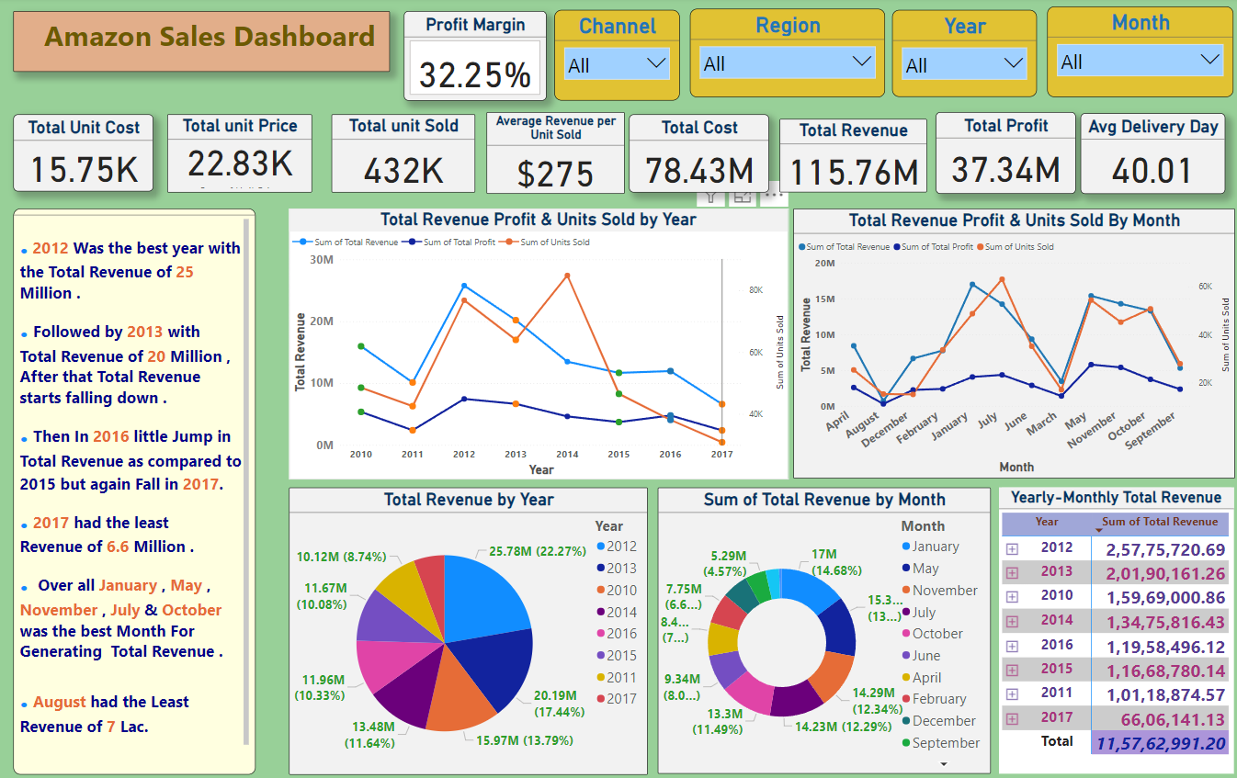

Slide 3
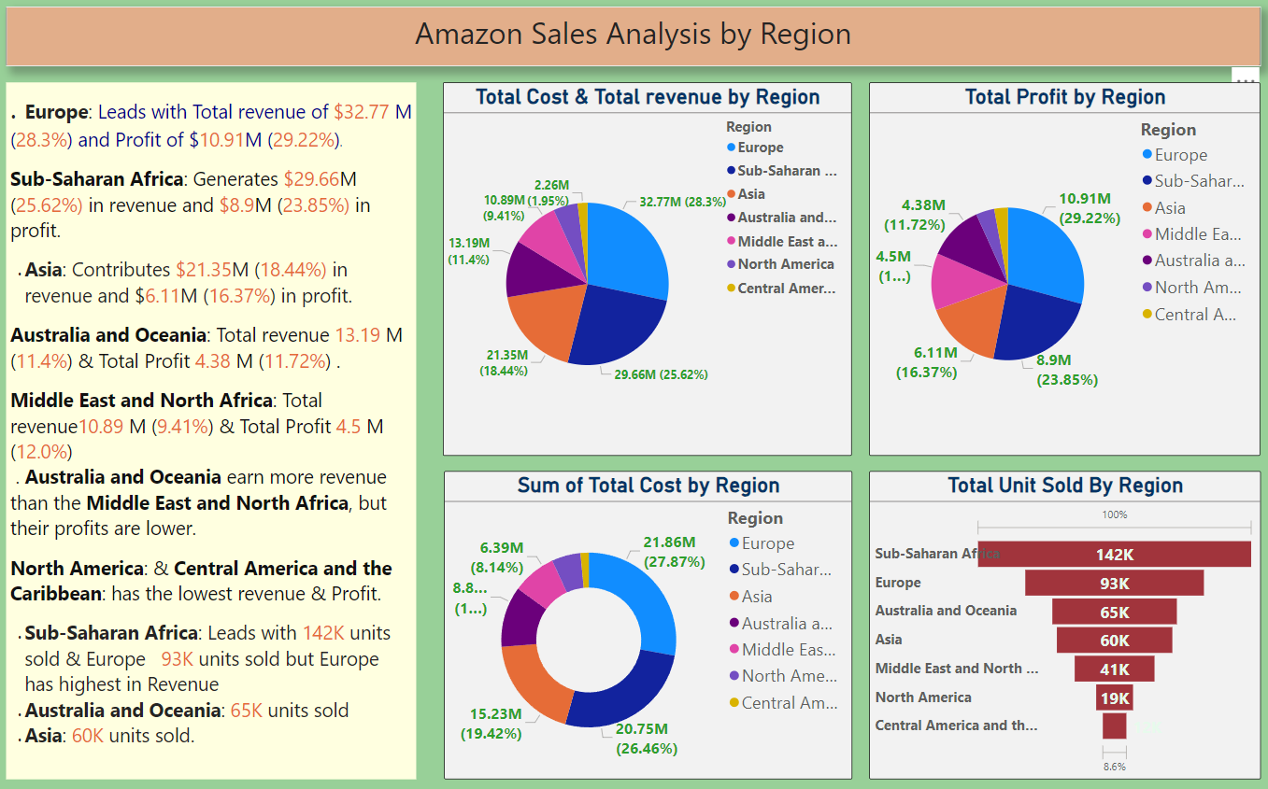

Slide 4
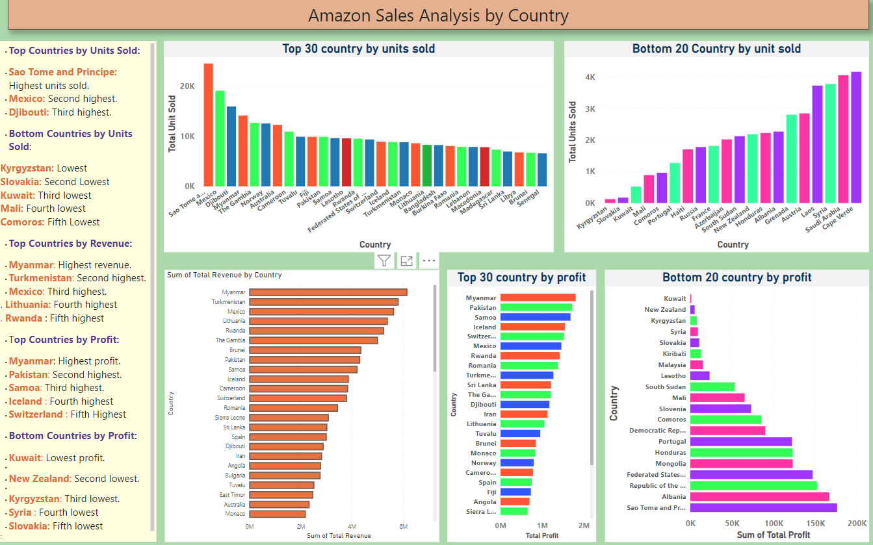

Slide 5
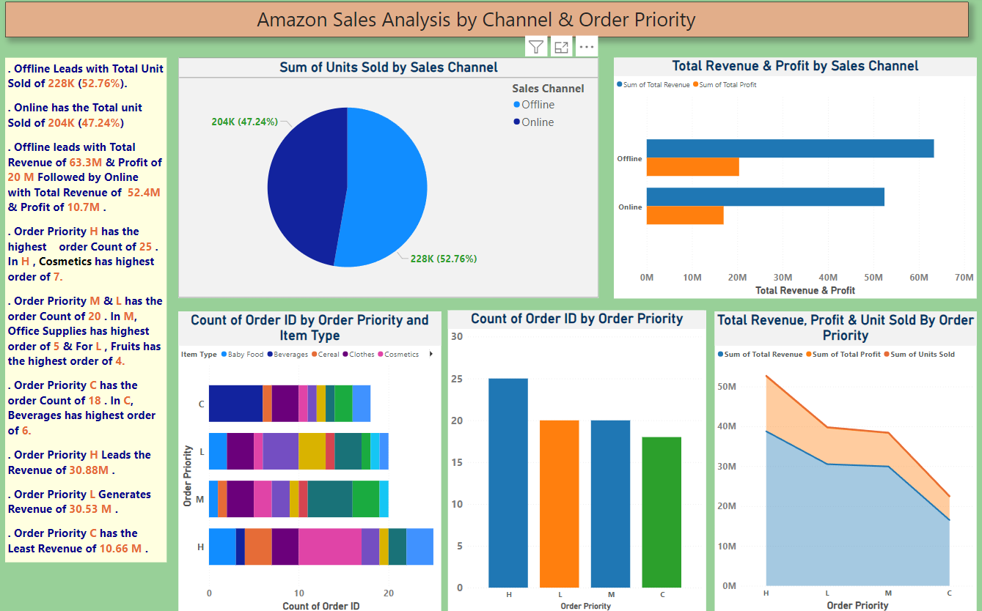

Slide 6
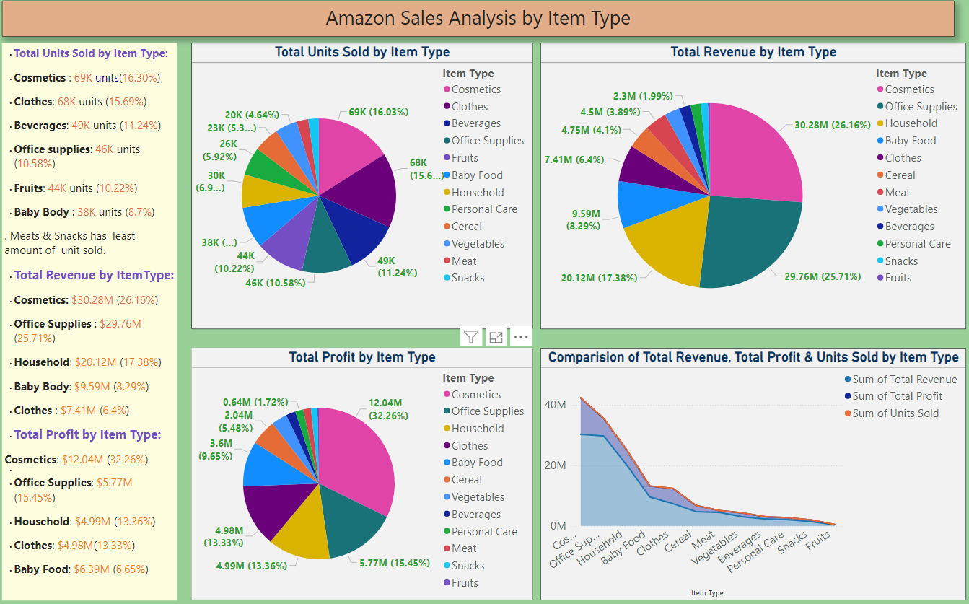

Slide 7
